Slide 1
Sequential Circuits
Design

Slide 2
Sequential Circuits
Inputs
output logic
Outputs
next state logic
Next State
Current State
x
D
Q
A
C
Q
A
D
Q
B
Clock
C
Q'
y

Slide 3
Design Example: Sequence Recognizer
A sequential circuit that recognizes the occurrence the bit sequence 1101 (The sequence 1101 must be recognized each time it occurs in the input sequence.)
Thus, the sequential machine must remember that the first two one's have occurred as it receives another symbol.
Input: X(t) ∈ {0, 1} Output: Z(t) ∈ {0, 1}
Time 0 1 2 3 4 5 6 7 8 9 10 11 12 13 14 15 16
X(t) 1 0 0 1 0 1 1 0 1 0 1 1 0 1 1 0 1
Z(t) 0 0 0 0 0 0 0 0 1 0 0 0 0 1 0 0 1

Slide 4
Obtain The State Diagran
Time 0 1 2 3 4 5 6 7 8 9 10 11 12 13 14 15 16
X(t) 1 0 0 1 0 1 1 0 1 0 1 1 0 1 1 0 1
Z(t) 0 0 0 0 0 0 0 0 1 0 0 0 0 1 0 0 1
1/1
1/0
0/0
1/0
S₀
S₁
S₂
S₃
0/0
0/0
1/0
0/0
A Mealy Machine

Slide 5
Obtain State Table
1/1
From the State Diagram, we can fill in the State Table.
Assign binary codes for the states
1/0
1/0
0/0
00
01
10
11
0/0
0/0
1/0
0/0
Present State |  | Input X | Next State |  | Output Z
A | B |  | A | B
0 | 0 | 0 | 0 | 0 | 0
0 | 0 | 1 | 0 | 1 | 0
0 | 1 | 0 | 0 | 0 | 0
0 | 1 | 1 | 1 | 0 | 0
1 | 0 | 0 | 1 | 1 | 0
1 | 0 | 1 | 1 | 0 | 0
1 | 1 | 0 | 0 | 0 | 0
1 | 1 | 1 | 0 | 1 | 1
Present State AB | Next State x = 0 x = 1 |  | Output x = 0 x = 1
0 0 | 0 0 | 0 1 | 0 | 0
0 1 | 0 0 | 1 0 | 0 | 0
1 0 | 1 1 | 1 0 | 0 | 0
1 1 | 0 0 | 0 1 | 0 | 1

Slide 6
Find Flip-Flop Input and Output Equations
Select the flip-flop types. (D flip flop)
Derive flip-flop input equations.
Present State |  | X | Next State |  | Z
A | B |  | A | B
0 | 0 | 0 | 0 | 0 | 0
0 | 0 | 1 | 0 | 1 | 0
0 | 1 | 0 | 0 | 0 | 0
0 | 1 | 1 | 1 | 0 | 0
1 | 0 | 0 | 1 | 1 | 0
1 | 0 | 1 | 1 | 0 | 0
1 | 1 | 0 | 0 | 0 | 0
1 | 1 | 1 | 0 | 1 | 1
AB
X
 | 00 | 01 | 11 | 10
0 | 0 | 0 | 0 | 1
1 | 0 | 1 | 0 | 1
AB
X
 | 00 | 01 | 11 | 10
0 | 0 | 0 | 0 | 1
1 | 1 | 0 | 1 | 0

Slide 7
Draw Logic Diagram
X
Z
Clock

Slide 8
One Flip-flop per State (One-Hot) Assignment
1/1
1/0
1/0
0/0
0001
0010
0100
1000
0/0
0/0
1/0
0/0
Present State | Next State x = 0 x = 1 |  | Output x = 0 x = 1
0001 | 0001 | 0010 | 0 | 0
0010 | 0001 | 0100 | 0 | 0
0100 | 1000 | 0100 | 0 | 0
1000 | 0001 | 0010 | 0 | 1
Provides simplified analysis and design
Combinational logic may be simpler, but flip-flop cost higher

Slide 9
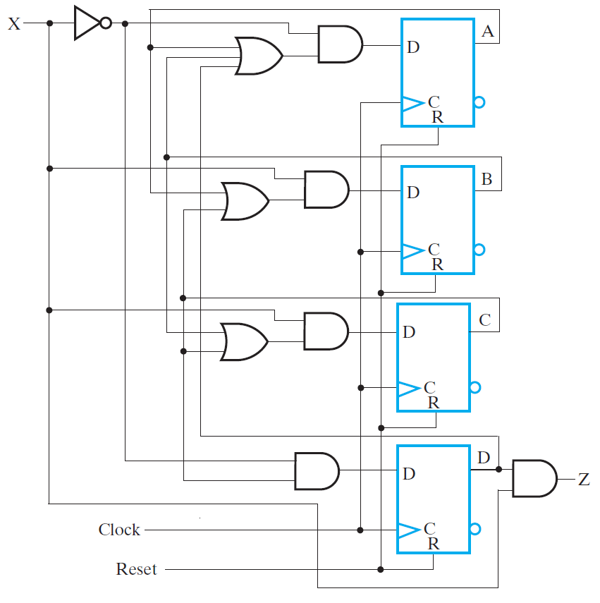

Slide 10
Design Example: modulo 3 accumulator for 2-bit operands
It adds each input operand to the stored sum, which is initially 0. Then takes the modulo.
(2 + 0) modulo 3 = 2, (1+2) modulo 3 = 0 …
Stored sum: (Y₁,Y₀), Input: (X₁,X₀), Output: (Z₁,Z₀)
00
Reset
A/00
Mealy or Moore?
01
C/10
B/01

Slide 11
The State Machine Diagram Model (SMD)
Input Variables A, B, C Output Variables Y, Z Default: Y = 0, Z = 0
S0
A⋅B
S1
S0
A⋅B
S1
A + B
Transition condition (TC)
A + B
Y, Z
A/Y, B/Z
S2
S2
Transition condition-independent (TCI)
Moore Outputs
TCI Outputs
Transition condition-dependent (TCD)
A⋅B/Y
C/Y
S0
S1
A⋅B
S0
S1
(A + B)/Z
C/Y
(A + B)
S2
S2
Transition and output condition-dependent (TCOD)
TCD Outputs
TCOD Outputs

Slide 12
Example-1
Defaults: Y = 0, Z = 0
Y, Z
A/Y, B/Z
S0
A⋅B
S1
A + B
BC
A/Z
A⋅C
A + C
B⋅C
A/Y
(B + C)/Z
S3
S2
B⋅C/Y
What is the state table for this SMD?

Slide 13
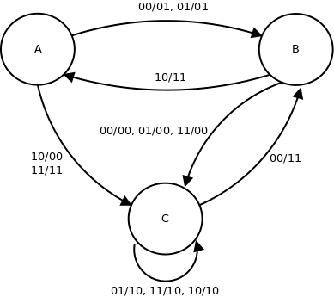
Example-2
What is the SMD for this state diagram?

